Slide 1
529 Advance Data Analytics:Mid-term Project
Information Technology & Management
Shushmitha Anthay Suthakaran
A20355725
Housing Affordability Data

Slide 2
Table of Content
Business Scenario
Business Objective
Selected Data
Analyzing Response and Predictor Variables
Exploratory Analysis
Regression Modeling (PROC GLM)
Regression Modeling (PROC LOGISTIC)
Regression Modeling (PROC REG)
Summary

Slide 3
Business Scenario
U.S. Department of Housing and Urban Development (HUD) has helped low-income households obtain better rental housing and reduce the share of their income that goes toward rent through a program that relies on the private rental market.
Since 2000, rents have risen while the number of renters who need low-priced housing have also increased. These factors make finding affordable housing even tougher for very poor households in America.
Not a single county in the United States has enough affordable housing for all its extremely low-income (ELI) renters. For the department to understand how to be able to reduce the Fair Market Rent for low-income renters, it is needed to understand what is influencing the Fair Market Rent to be high.

Slide 4
Business Objective
The Key objective for the analysis are:
Which variables have an effect on determining the “Fair Market Rent”?
Considering “Number of bedrooms in the unit”, “Recoded structure type”, “Census Region” as variables given in the applicant.
How much variability can be explained by this set of variables?
What is the probability in change of the Fair Market Rent?
“Household Income”
“Number of bedrooms”
Given these objectives, can we judge whether an “Extremely Low Income” group has benefited from this renting scheme when compared to “Very Low Income” and “Low Income” ?

Slide 5
Source Data set
The dataset is obtained from the American Housing Survey (AHS) site as cited below: Under the Housing Affordability Data System: “HADS Data derived from AHS National Data”, the SAS version for year 2013 has been selected for analysis.
File Name: hads2013n.sas7bdat
Source of Data: https://www.huduser.gov/portal/datasets/hads/hads.html
Total number of records: 64535
Total number of attributes: 99
Time Period: 2013

Slide 6
Identifying Variable – Response Variable (Y)
Dependent Variable (Y): Variables of interest in an experiment i.e. those that are measured or observed are called response or dependent variables.
‘Response’ variable is “Fair Market Rent” (FMR).
“Fair Market Rent” plays different roles in the certificate and voucher programs. i.e. In the certificate program, Fair Market Rent set limits on what units can be rented; in the voucher program, Fair Market Rent set limits on the subsidy provided to the household.
Response variable Y | FMR | Numerical data | Fair market rent (average)

Slide 7
Identifying Variable – Predictor Variable (X)
Predictor Variable(X): variables in the experiment that affect the response and can be set or measured by predictor, explanatory, or independent variables.
These predictor variables which explain and influence on “Fair Market Rent” are location, income, units etc.
The “Household Income” is categorized in 4 bin with low, medium, high and very high.
Variables | Variable name | Continuous or Categorical data
Household Income ($) | ZINC2 | Continuous
Extremely low income (average) | L30 | Continuous
Very low income (average) | L50 | Continuous
Low income (average) | L80 | Continuous
Number of bedrooms in unit | BEDRMS | Categorical
Recoded structure type | StructureType | Categorical
Census Region | Region | Categorical

Slide 8
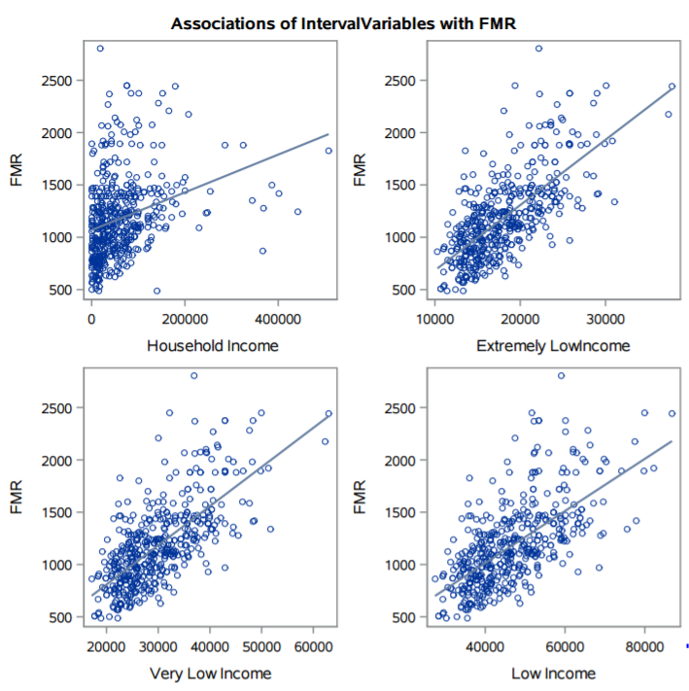
Exploratory Analysis (Continuous variables)
Association – Continuous Variables
On analyzing the predictor and response variables, it is observed that “Household Income”, “Extremely Low Income”, “Very Low Income” and “Low Income” have a linear relationship with “Fair Market Rent”.
Using this we develop a model which will predict the “Fair Market Rent” value with respect to individual attributes.

Slide 9
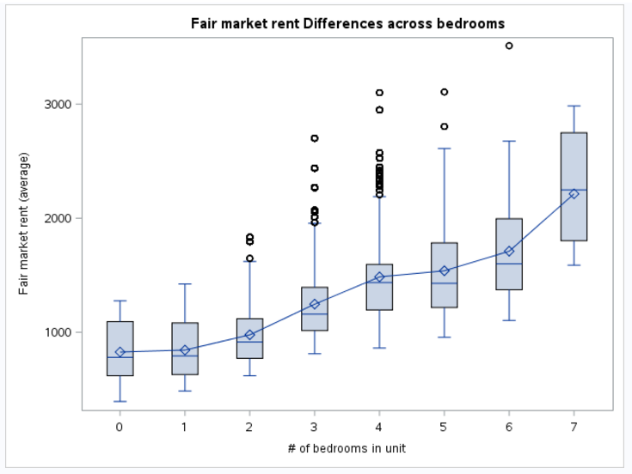
Exploratory Analysis (Categorical variables)
Association – Categorical Variables
There is an increase in “Fair Market Rent” value with increase in “Number of Bedrooms”.
As observed in the plot, the “Fair Market Rent” is maximum when the “Number of Bedrooms” is 7.

Slide 10
Exploratory Analysis (R-square and P value)
Predictor variables which disprove the “null hypothesis” i.e. Pr<0.05 and which have a positive R-square value are considered.
The table shows a list of predictor variables with their corresponding exploratory values.
Variable name | R-square | P- value | used ?
Structure Type | 0.1333 | <.0001 | Yes
Region | 0.2457 | <.0001 | Yes
Bed Rooms | 0.4074 | <.0001 | Yes
ZINC2 | 0.8684 | <.0001 | Yes
L30 | 0.4432 | <.0001 | Yes
L50 | 0.4433 | <.0001 | Yes
L80 | 0.3975 | <.0001 | Yes
Tenure | 0.0543 | <.0258 | NO
Status | 0.0134 | <.0002 | NO

Slide 11
Exploratory Analysis – Techniques Used
We are running regression models, both for a categorical response variable and a continuous response variable.
PROC REG
Response Variable - “Fair Market Rent”
Predictor Variables - “Extremely Low Income” , “Very Low Income”, ”Low Income”.
PROC GLM
Response Variable - “Fair Market Rent”
Predictor Variables - “Number of bedrooms in the unit”, “Recoded structure type”, “Census Region”
PROC LOGISTIC
Response Variable - “Fair Market Rent”
Predictor Variables – “Household Income”, “Number of bedrooms in the unit”.

Slide 12
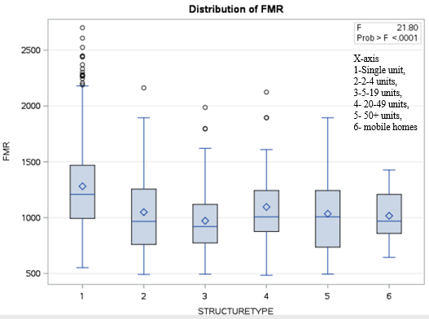
Regression Modeling Results: (Objective-1a) GLM (Structure type)
“Structure type” explains the model of the building i.e. duplex, townhouse, and condominiums with the number of units in each.
“Structure type” explains a 13% variability in “Fair Market Rent”.
It is observed that a “structure type” of single unit has the highest “Fair Market Rent” value when compared to the other.

Slide 13
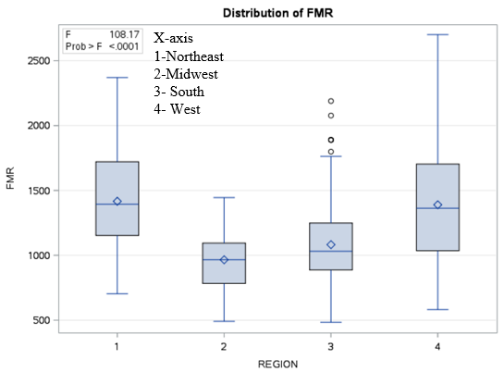
Regression Modeling Results: (Objective-1a) GLM (Region)
We observe that region plays a vital role in determining the “Fair Market Rent”. From the dataset we notice Northeast has a Greater Supply of Affordable Housing for Renters than the South or the Midwest.
It explains a 24% variability in the “Fair Market Rent”. It is observed that the “Fair Market Rent” of northeast and west is higher compared to the “Fair Market Rent” of the Midwest and south.

Slide 14
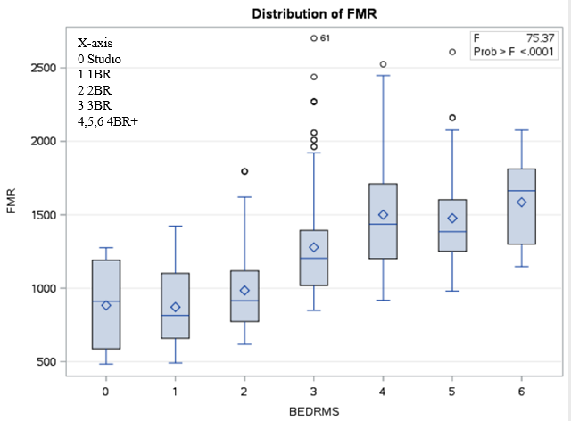
Regression Modeling Results: (Objective-1a) GLM (Number Of Bedrooms Unit)
Affordable rents for housing units vary by the “Number of Bedrooms” in the housing unit. Higher “Number of Bedrooms” would explain a rise in the “Fair Market Rent”.
“Number of Bedrooms” explains 41% variability in the “Fair Market Rent”.

Slide 15
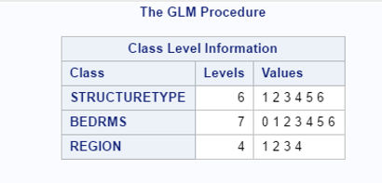
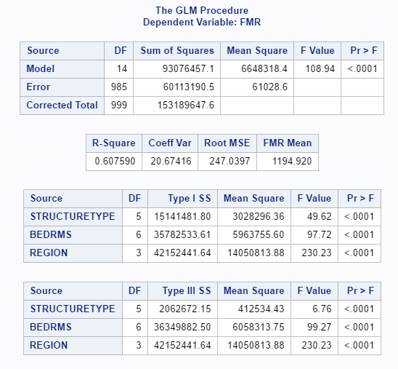
Regression Modeling Results: (Objective-1b) GLM(Structure Type, Region, No Of Bedrooms)
The table shows that the combined effect of the variables “Structure Type”, “Region”, “No Of Bedrooms” explain a 60% variability in the “Fair Market Rent”.
This amount of variability explains a lot, and would be very important to understand why the low income groups members still have a high “Fair Market Rent”.

Slide 16
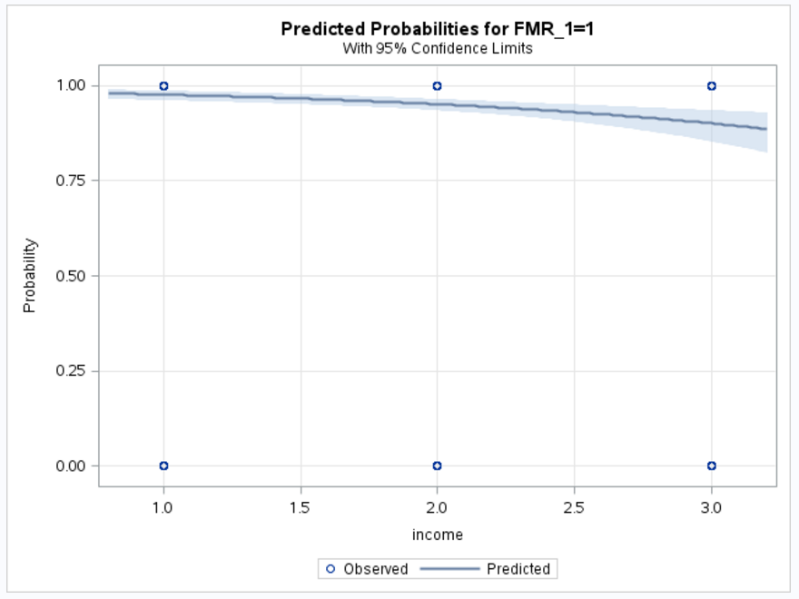
Regression Modeling Results: (Objective-2a) LOGISTIC (Household Income)
The “Household Income” is categorized in 4 bin with low, medium, high and very high.
It is observed us that the probability of the “Fair Market Rent” to be less than $2,000 comes down when the “Household Income” increases.
The value of the “Fair Market Rent” is from $0 to $2,000.

Slide 17
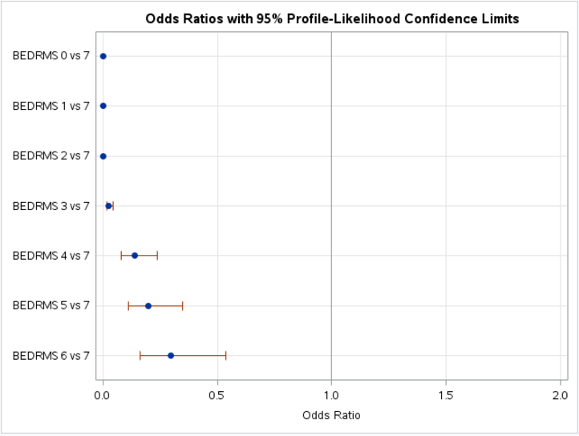
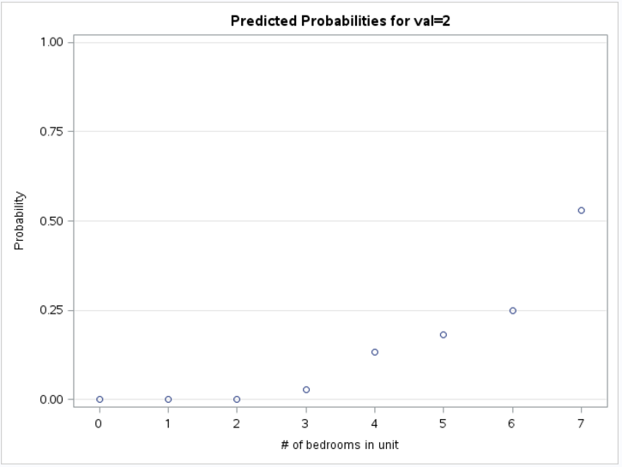
Regression Modeling Results: (Objective-2b) LOGISTIC (Number of Bedroom unit)
It is observed that the probability of increase in the “Fair Market Rent” price increases with increase in the “Number of Bedrooms”.
The bedroom is an categorical variable with category 1-7.
“Fair Market Rent” is converted in 2 categorical bins. Low and high bin.

Slide 18
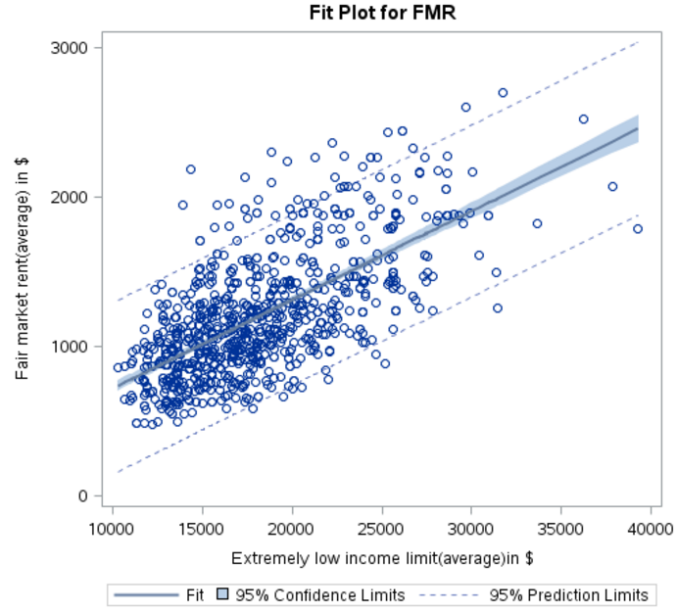
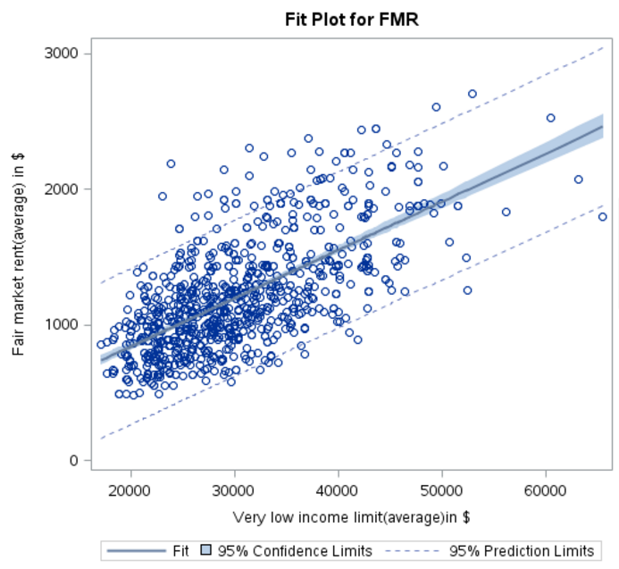
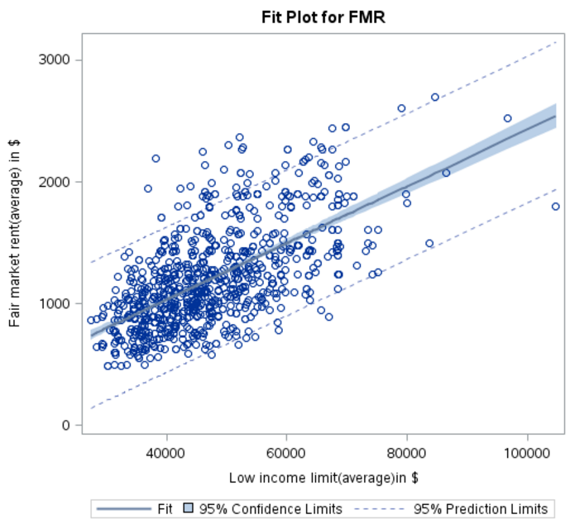
Regression Modeling Results: (Objective-3) REG (Extremely Low Income, Very Low Income, Low Income)
It is observed from the chart below that a 39% increase in the income from “L30” to “L50” still comes under the same bracket of the “Fair Market Rent”.
Similarly, a 36% increase in income from “L50” to “L80” also has the same bracket of “Fair Market Rent”.
This shows us the irrespective of the income levels, the low income group is still spending similar to the other groups.

Slide 19
Summary
From the analysis , We concluded
Objective 1:
The categorical variable “structure type”, “region” and “bedroom” have a significant effect on the determining the “Fair Market Rent” with 13%, 24% and 41% explained variability respectively.
A total of 60% variability can be explained on the “Fair Market Rent” given the set of variables “structure type”, “region” and “bedroom”.
Objective 2:
The probability of the “Fair Market Rent” to be less than $2,000 decreases when the income increases.
The probability of the “Fair Market Rent” price increases with increase in the number of bedrooms.
Objective 3:
The analysis predicts that irrespective of the income levels, the “Extremely Low Income” group is still spending similar to the other groups, hence there are no benefits for the “Extremely Low Income” group.
This is evidence enough for us to understand that the “Extremely Low Income” are not benefitting from the Fair Market Rent policy.

